Slide 1


US County Data Analysis
Presented by Adam Curry
Bellevue University DSC680 – Applied Data Science

Slide 2
Presentation Format
Domain – What domain is this data going to come from?
Data Used – Where did the data come from? What variables were used?
Research Questions – What questions will be answered from this analysis?
Data Prep – What was the data preparation process?
Methods – What methods were used?
Findings – What did the analysis reveal?
Conclusion – What’s next?

Slide 3
Domain – US County Metrics
County level data reveal insight on the community
COVID19 may have impacted the election
Election fraud… is Benford’s Law the “smoking gun”?
Notes:
A lot can be learned by variables studied at the count level. Insight about the counties economy and crime rates can determine growth in the county.
Covid cases and death rates were said to be an influence in the 2020 election. Could this also be true at the county level?
Election fraud was a hot topic in the 2020 election and Benford’s Law was being tossed around like it was the smoking gun for fraud. County level data may offer some additional insight.

Slide 4
Data Used
Data sourced from Kaggle, gathered by FiveThirtyEight and DataWorld
All variables will be used for different parts of this analysis.
Notes:
The variables include: 2020/2016 presidential voting (at the candidate level), commute methods, (carpool, transit, walk, etc.), income (total and per capita), demographic, COVID cases/deaths (as of 11/2020), employment data (sector, unemployment), and population data

Slide 5
Research Questions – What questions will be answered from this analysis
Did covid numbers influence the 2020 election?
Is it possible to predict if a county is republican or democrat without using non-voting variables (i.e., covid cases/deaths, poverty, profession)?
Will classifying counties and combining them with other like counties across the country help increase the levels of magnitude required to meet Benford’s Law?
Are the observed values the same as the theoretical Benford's law values?
Notes:
Hypothesis Question # 1 - Did covid numbers influence the 2020 election?
Hypothesis Question # 2 - Is it possible to predict if a county is republican or democrat without using non-voting variables (i.e., covid cases/deaths, poverty, profession)?
Hypothesis Question # 3 - Will classifying counties and combining them with other like counties across the country help increase the levels of magnitude required to meet Benford’s Law?
Hypothesis Question # 4 - Are the observed values the same as the theoretical Benford's law values?

Slide 6
Methods
Multilinear Regression analysis
Primary Component Analysis
Decision Tree and Random Forest Classification
Benford’s Law (first digit law)
Notes:
Multilinear regression – this was the primary method used when reviewing whether the COVID case and deaths had any variation on the year over year percent of voting. The input variables were covid cases and covid daeths as of 11/2020
Primary Component Analysis – this was used as to reduce the number of features within the dataset from greater than 30 down to 2 components. This was then applied in the classification modeling.
Decision Tree and Random Forest classification models were used to predict if a county was republican or democrat. The primary inputs were the party classification metric that was derived early on in the analysis and the PCA components.
Benford’s law (i.e. the first digit law) “states that in listings, tables of statistics, etc., the digit 1 tends to occur with probability ∼30%, much greater than the expected 11.1% (i.e., one digit out of nine). Benford's law can be observed, for instance, by examining tables of logarithms and noting that the first pages are much more worn and smudged than later pages”. Benford’s Law has been described by some as a smoking gun for election fraud. However, the analysis they reference fail to meet the basic principals of Benford’s law: the numbers within the dataset need to be random and not assigned, with no imposed minimums or maximums; the numbers should cover several orders of magnitude, and the dataset should be large; recommendations call for 100 to 1,000 samples as a minimum [5]. As a side note, many people who claim Benford’s Law is the “smoking gun” for election get this wrong. Many seasoned statisticians have debunked the use of Benford’s Law on election data sighting a violation of the orders of magnitude principal. However, this analysis will review the data in a slightly different manner. In order to increase the orders of magnitude, county level data spanning across the country was used, increasing the magnitude from 100 – 1,000 to 10 to 1,000,000.

Slide 7
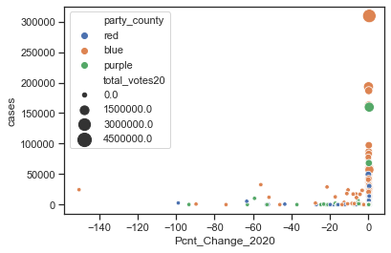
Findings 1 of 3 – COVID impact on election
Total votes were highly correlated to covid case data and negatively correlated to the percentage change year over year
Percent voting year over year change was target variable
Notes:
Total votes were highly correlated to covid case and death data but were also negatively correlated to the percentage change year over year.
It’s hard to make a determination based on two variables (cases and deaths), but based on these findings, COVID cases and deaths don't appear to have much impact on the overall election results. Broken into three categories shows a range of R² 0.165 - 0.269. The p-value shows COVID cases may've impacted the change in votes in red counties (p-value < .000), but in every other county type, COVID cases and deaths were all greater than .05.

Slide 8
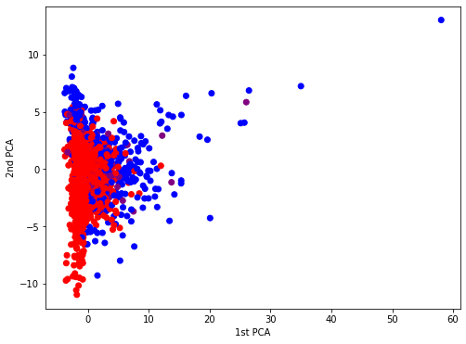
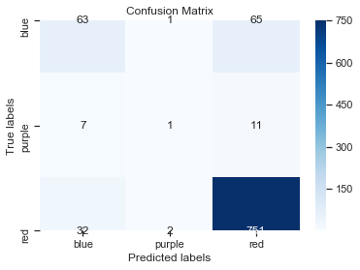
Findings 2 of 3 – PCA and Classifying Counties
Reduced features to two components down from > 30
Predicted red counties easily
Overall accuracy
Notes:
The next step was to classify the data using non-voting variables. This was done using a combination of techniques. First, I conducted a principal component analysis to reduce the number of features to two (down from > 30). The scatter plot shows the relationship categorized by party affiliation. Red – republican, Blue – democrat, and Purple – Independent
Then I ran the data through sklearn’s DecisionTreeClassifier and RandomForestClassifier. I found that the republican party frequency was easy to predict, but the democrat and independent counties weren’t. This is most likely a result of the number of “red” counties vs. the number of “blue” counties. The confusion matrix on the right shows how the True lables compared to the predicted labels. As you can see, 751 red counties were predicted correctly where only about 50% of the blue counties were predicted correctly.
Both model’s average accuracy was good: the decision tree predicted 83% of the records correct and 87% correct in the random forest.

Slide 9
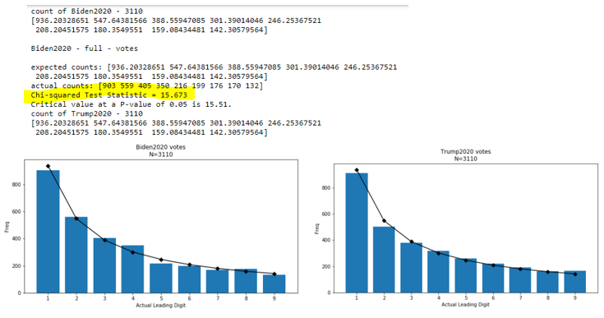
Findings 3 of 3 – Benford’s Law
Orders of magnitude increased meets requirement
Observed values for Biden in the 2020 election at the county level were not the same as the theorietical values
Notes:
Using county level data across the country, instead of county level data at the state level increases the orders of magnitude from 10 - 1000 to 10 to 1,000,000. With my current understanding, I THINK this data set qualifies based on the orders of magnitude and the numbers should be random.
The findings revealed that the chi-squared test statistic is 15.673, which is greater than 15.51. Meaning, the difference in the distribution is statistically significant and the theoretical values are different from the observed values (i.e. “smoking gun” crowd would be happy with this). However, this doesn't mean there was election fraud, as I've pointed out, there are several expert statisticians who have indicated the use of Benford's law in election data isn't advised. Also, I only spot checked the dataset. There may be data discrepancies missing or incorrect values. At this point, it is just interesting that at the county level, where it appears the principals of Benford’s law are met, there is a significance in observed voting totals versus theoretical voting totals for the 2020 election.

Slide 10
Conclusion
Notes:
The “next steps” I could take for this analysis would require a much stronger understanding of first digit analysis. Entire research papers have been dedicated to analyzing second digit and even last digit analysis [6][7]. Perhaps I will take some time to understand what each digit could represent and take the Benford’s Law analysis a step further. For the classification analyses, I would need additional years’ worth of data to get a robust model. The limited dataset I have doesn’t seem to offer enough observations to properly classify non-red counties.

Slide 11
Questions?
What steps did you take to validate the county level metrics?
How can you be certain you met Benford’s Law basic principles?
What were the counties that were outliers in the scatterplot?
Could removing the outliers help the Covid analysis?
Why did you leave percent voted in your PCA?
Would removing LA county from your PCA have any impact on the classification?
Why didn’t you use the “purple” classification in Benford’s Law analysis?
How did you come up with the calculation for Benford’s law?
How did you come up with the chi-squared critical value?
Did you notice any specific variable that stood out as the biggest influence in the PCA?
How did you account for missing values in the dataset?
Notes:
What steps did you take to validate the county level metrics? After cleaning the dataset, I Googled a few states to see the number of counties within each state
How can you be certain you met Benford’s Law basic principles? I can only be as certain as my understanding of the basic principals (orders of magnitude and random numbers)
What were the counties that were outliers in the scatterplot? The large one was LA County.
Could removing the outliers help the Covid analysis? That is a good point, removing outliers could help. But those are true counties, which makes me think they should be included.
Would removing LA county from your PCA have any impact on the classification? Probably. I actually may go back and see what removing the two outliers would do to the analysis.
Why didn’t you use the “purple” classification in Benford’s Law analysis? There weren’t enough values to meet Benford’s law > 50 observations.
How did you come up with the calculation for Benford’s law? I used a logarithmic calculation from the internet.
How did you come up with the chi-squared critical value? There are 9 observations in Benford’s calculation, so 8 degrees of freedom translates to 15.51.
Did you notice any specific variable that stood out as the biggest influence in the PCA? Unfortunately, I didn’t dive too far into the PCA details.
How did you account for missing values in the dataset? I imputed them with the median values.

